Slide 1


Final Project
Programming Fundamentals
presented by:
Saira Wahid
Muntaha Ayaz
Nazish Khan
Zunaira Javed

Slide 2

Dataset Introduction
This is the classic marketing bank dataset uploaded originally in the UCI Machine Learning Repository. The dataset gives information about a marketing campaign of a financial institution in which we will have to analyze in order to find ways to look for future strategies in order to improve future marketing campaigns for the bank.

Slide 3

Methodology used in analysis
Data Collection and Loading: Import data.
Data Cleaning: Handled missing data, removed duplicates, and standardize.
Data Exploration: Calculated stats, visualized.
Data Manipulation: Scaled data, Label Encoding
Data Visualization: Created informative visualizations.

Slide 4



Data Preparation and Analysis
Data Import and Preprocessing:
Import libraries (pandas, NumPy, matplotlib).
Load and manipulate data using Pandas Data Frames.
Data Visualization:
Create informative plots (Matplotlib, Seaborn).
Explore and visualize data patterns.
Data Splitting:
Use train_test_split for data partitioning.
Ensure unbiased model evaluation.
Data Scaling:
Applied Minmax Scaler to normalize numerical features.
Enhance machine learning model performance.

Slide 5

Model Setup and Evaluation
Model Setup:
Build a Sequential model with Keras.
Configure layers (LSTM, Dense).
Optimization:
Use the Adam optimizer for training.
Define loss functions and metrics.
Model Training & Evaluation:
Train the model.
Assess performance with confusion matrix and classification report.
Summary & Next Steps:
Recap key steps.
Discuss potential follow-up actions.

Slide 6
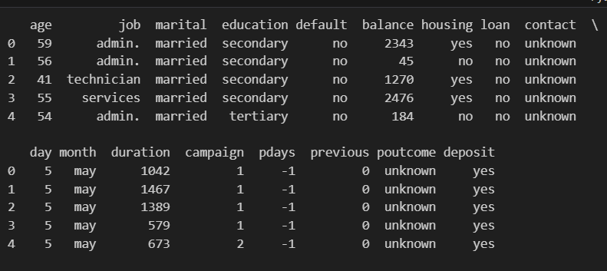
Exploratory Data Analysis
This is head snippet of dataset demonstrates sample data for a marketing campaign.
It includes various features such as age, job, marital status, education, and more.
The data is stored in a Pandas Data Frame for analysis and modeling.
This serves as an example dataset for our analysis.

Slide 7
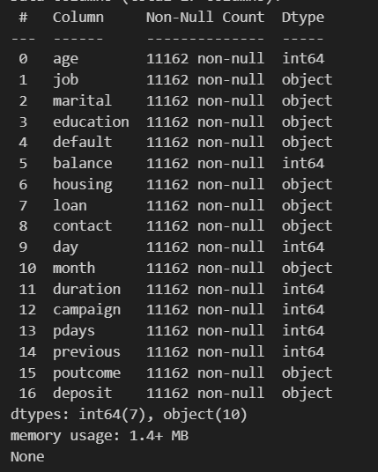
Exploratory Data Analysis
This summary provides an overview of the dataset's size and structure.
It highlights the data types of columns and the absence of missing values.
The dataset is suitable for analysis and modeling.

Slide 8
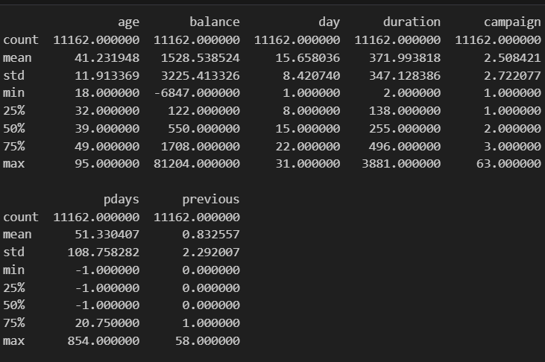
Exploratory Data Analysis
This table summarizes key descriptive statistics for numeric columns in the dataset.
It helps understand the central tendency, variability, and range of the data.
Useful for identifying potential outliers and understanding feature distributions.

Slide 9
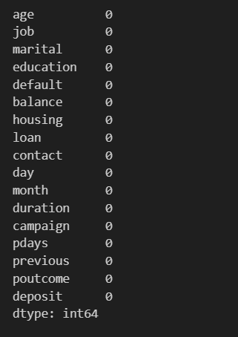
Exploratory Data Analysis
No missing valuesin dataset

Slide 10
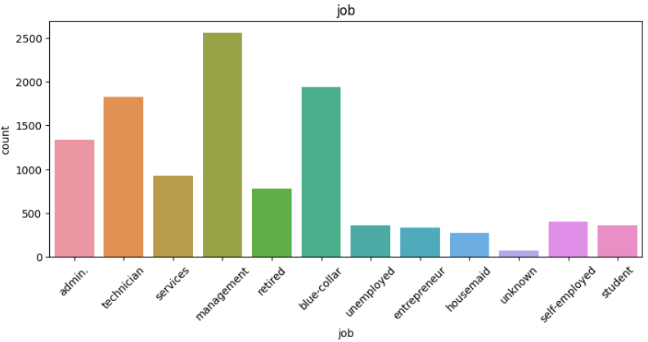
Data Visulaization
Distribution of Categorical Features

Slide 11
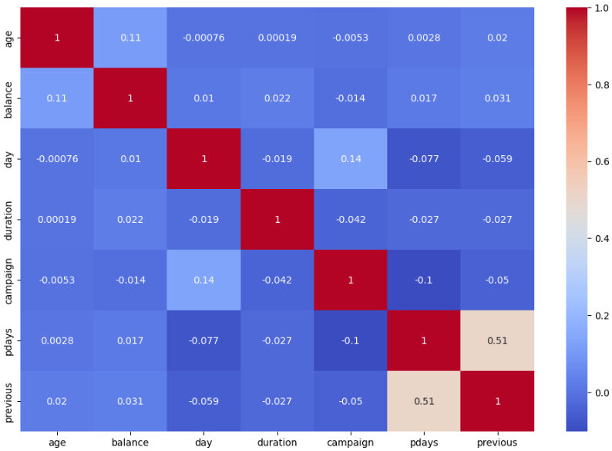
Data Visulaization
Correlation Analysis

Slide 12
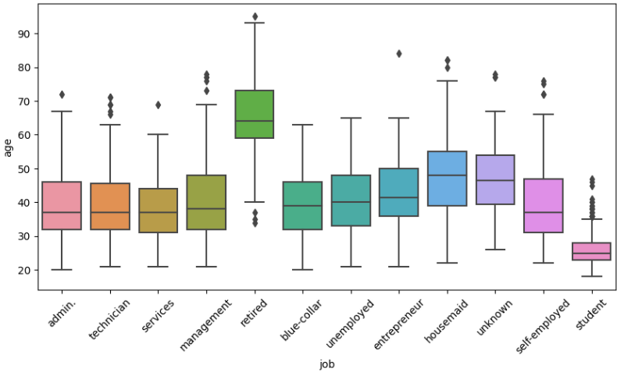
Data Visulaization
Boxplots for Numerical Variables by Categories

Slide 13
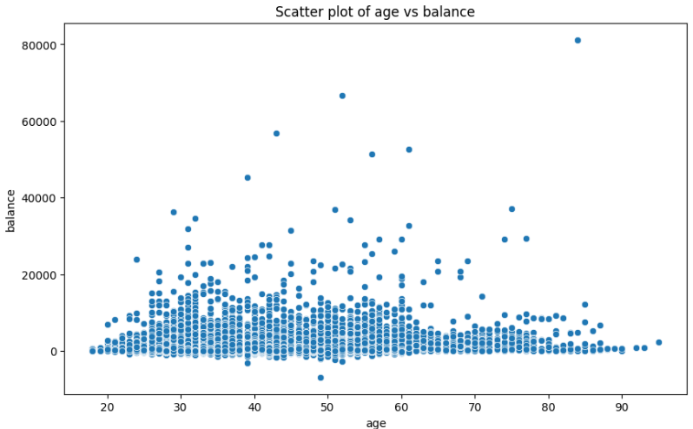
Data Visulaization
Scatter Plots for Pairwise Numerical Feature Relationships

Slide 14
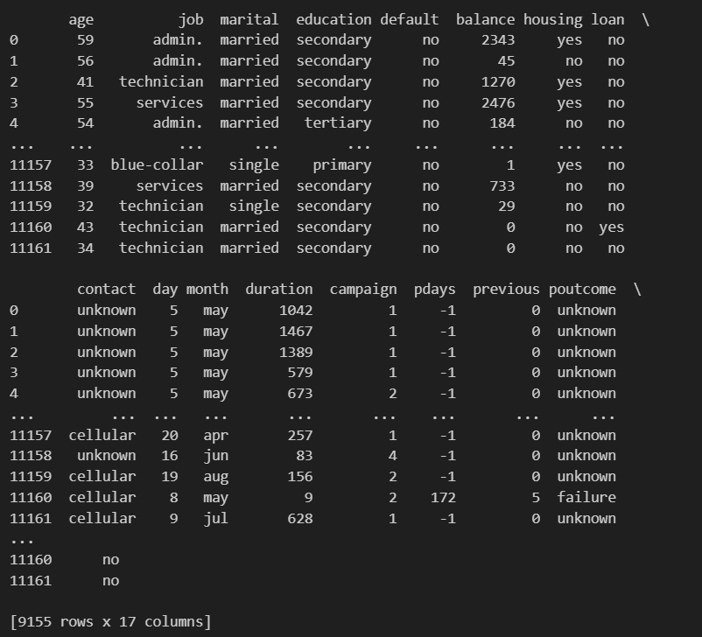
Data Manipulaiton
Data Filtering Based on 'age' Column
We began by summarizing the dataset using data.describe(). Then, we filtered the data to include only individuals over 30 years old, creating a new dataset named filtered_data. This selective approach helps us concentrate our analysis on this specific age group, facilitating more targeted insights and decision-making within the dataset.

Slide 15
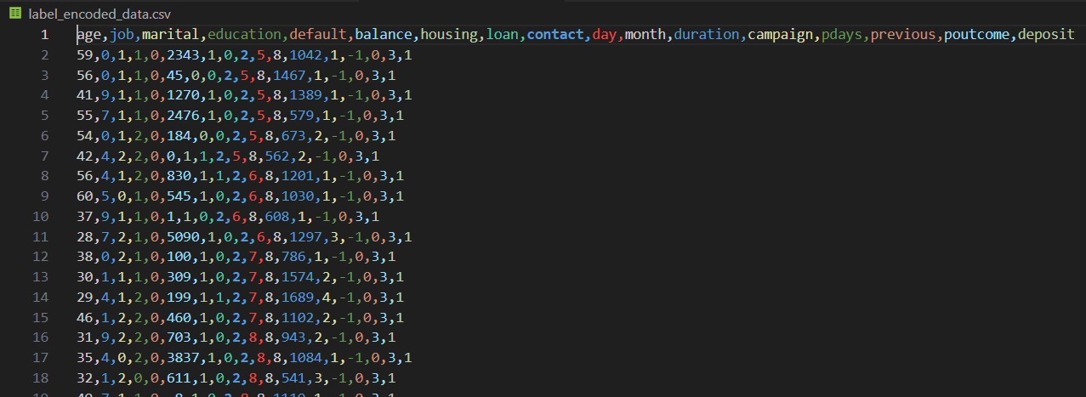
Data Manipulaiton
Label Enconding
Label Encoder from scikit-learn to encode categorical data into numerical format.
A loop iterates through specified categorical columns and applies label encoding.
The resulting label-encoded dataset is saved as 'label_encoded_data.csv.'
Label encoding is crucial for making categorical data compatible with machine learning algorithms.

Slide 16
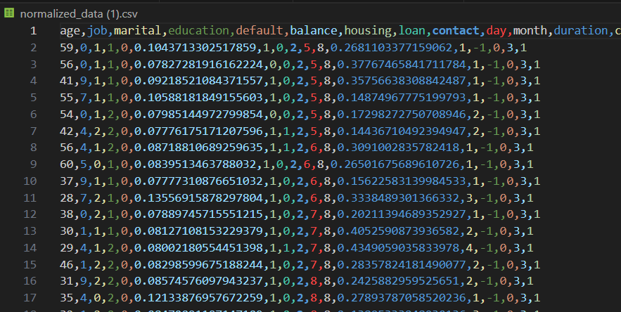
Data Manipulaiton
Data Normalization with Min-Max Scaling
MinMaxScaler from scikit-learn to normalize numerical data within a specific range.
Columns to be normalized (e.g., 'balance' and 'duration') are selected.
Min-Max scaling is applied to the chosen columns, ensuring values fall within the [0, 1] range.
The resulting normalized dataset is saved as 'normalized_data.csv.'
Data normalization is crucial for ensuring consistent and effective machine learning model training.

Slide 17
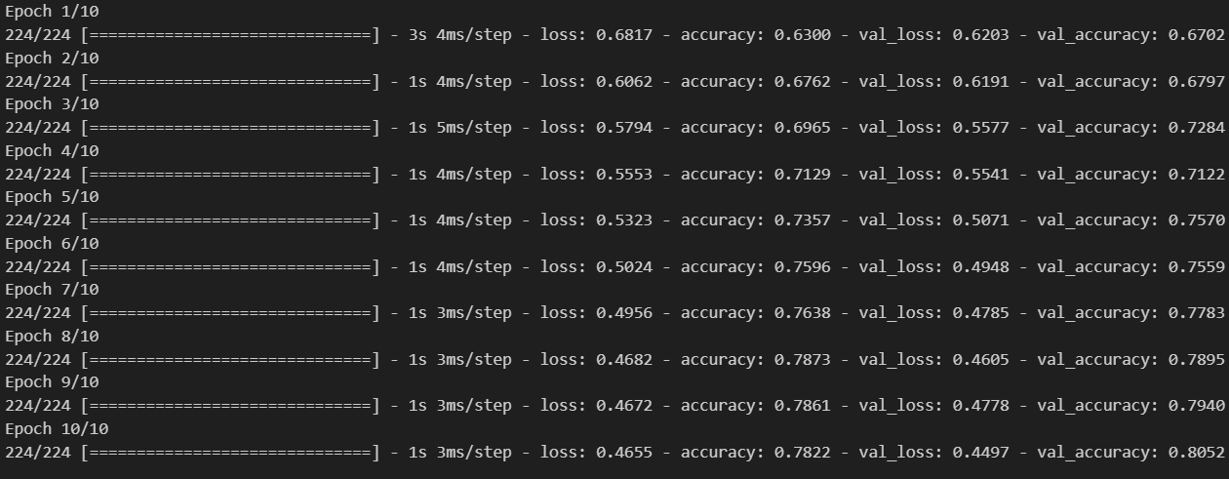
ML Model
Data Preprocessing and LSTM Model Setup
Loaded normalized data and splits it into features (X) and the target variable (y).
The dataset is divided into training and testing sets (80% training, 20% testing).
Data is reshaped to fit the input format required for LSTM (samples, time steps, features).
An LSTM model is constructed using Keras, consisting of one LSTM layer and an output layer.
The model is compiled with binary cross-entropy loss and the Adam optimizer.

Slide 18
Conclusion
In this data analysis process, we followed a systematic approach encompassing data loading, cleaning, exploration, manipulation, visualization, and model setup.
We began by importing data using Pandas, examining summary statistics with data.describe(), and visualizing distributions through box plots and other charts.
Data preprocessing included label encoding for categorical features and Min-Max scaling for numerical data to prepare it for machine learning and modeling.
We also showcased data filtering based on specific criteria (e.g., 'age' > 30), demonstrating how to extract subsets of data for targeted analysis.
Finally, we set up an LSTM model for predictive analysis, addressing the reshaping of data and model compilation using Keras.
Each step was designed to enhance data understanding, preparation, and modeling capabilities.
By following this structured approach, we can uncover valuable insights, make informed decisions, and build predictive models effectively.

Slide 19
THANK YOU!

